Slide 1
Activity Diagram
Amir Dirin 2023

Slide 2
Activity diagram
AD is a flowchart to represent the flow of control among the activities in system.
Shows the message from one activity to another, which the activity can be
Sequential
Branched or concurrent

Slide 3
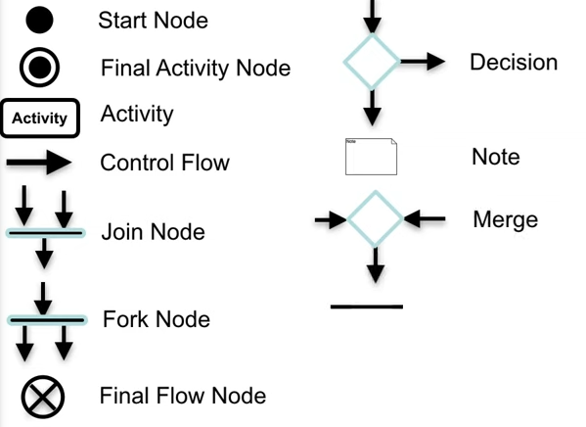
Notations

Slide 4
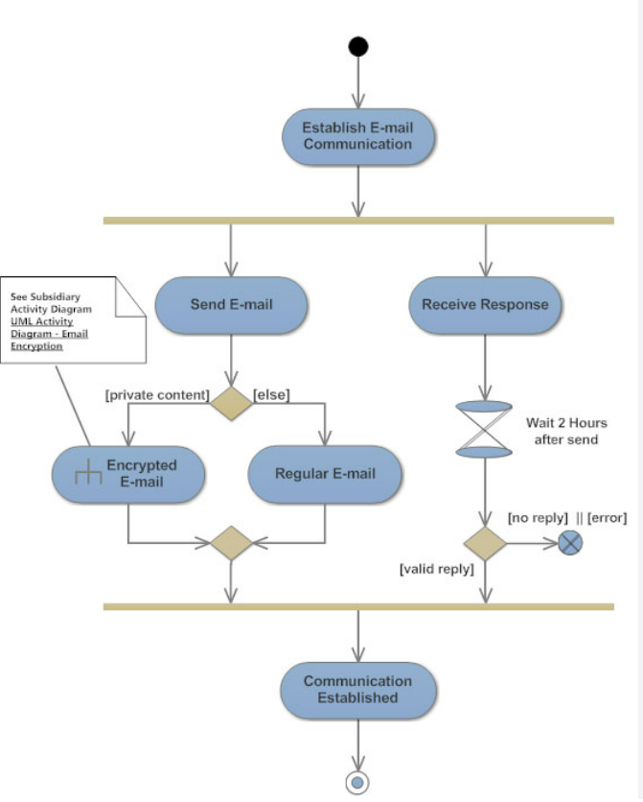




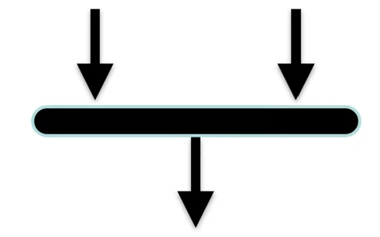
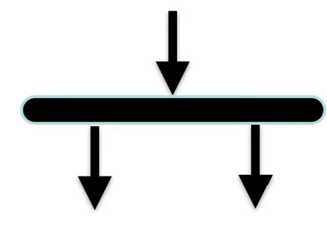
Notations
Start Node
Final Activity Node
Activity
Control Flow
Join Node
Fork Node

Slide 5
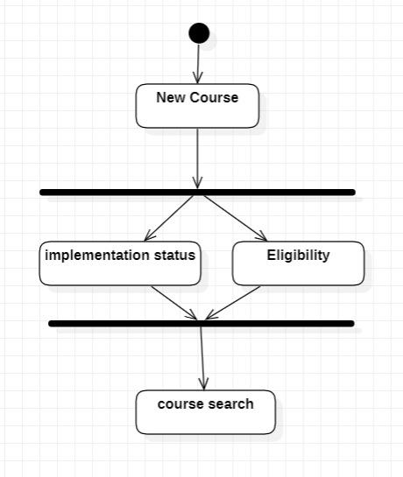
Course Registration (Example)
Fork Node
Joint Node

Slide 6
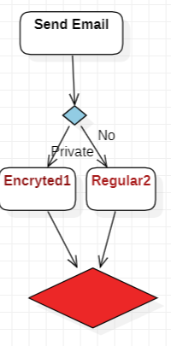
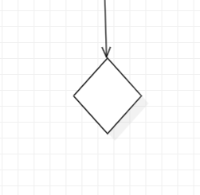
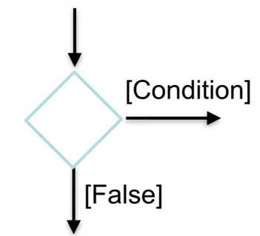
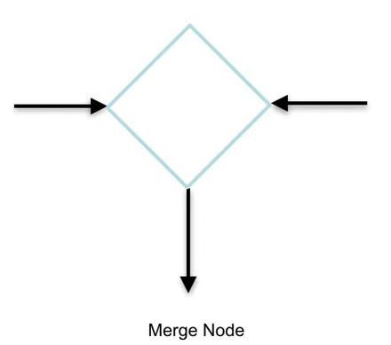
Notations
Decision
Condition
Merge Node
Two activities are merged with condition and only one activity flows forward

Slide 7
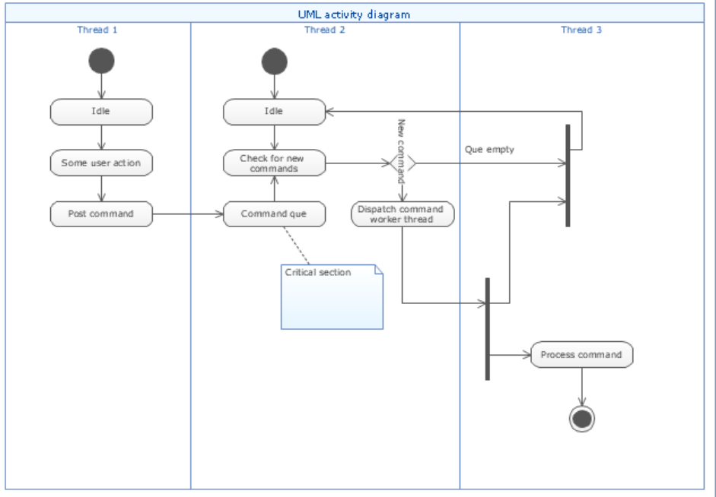
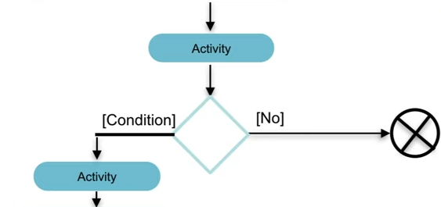
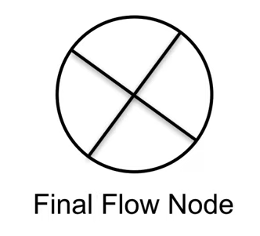
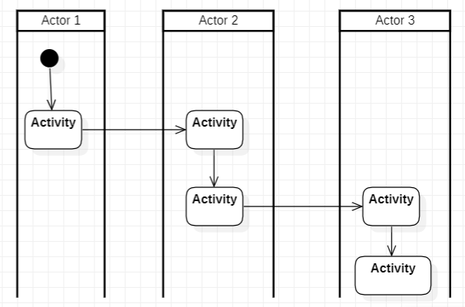
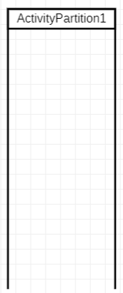
Notation
Final Node
Partition / Swimlanes

Slide 8
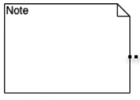


Notation
Note, add a relevant comments to elements
Sending Signal
Signal Receipt

Slide 9
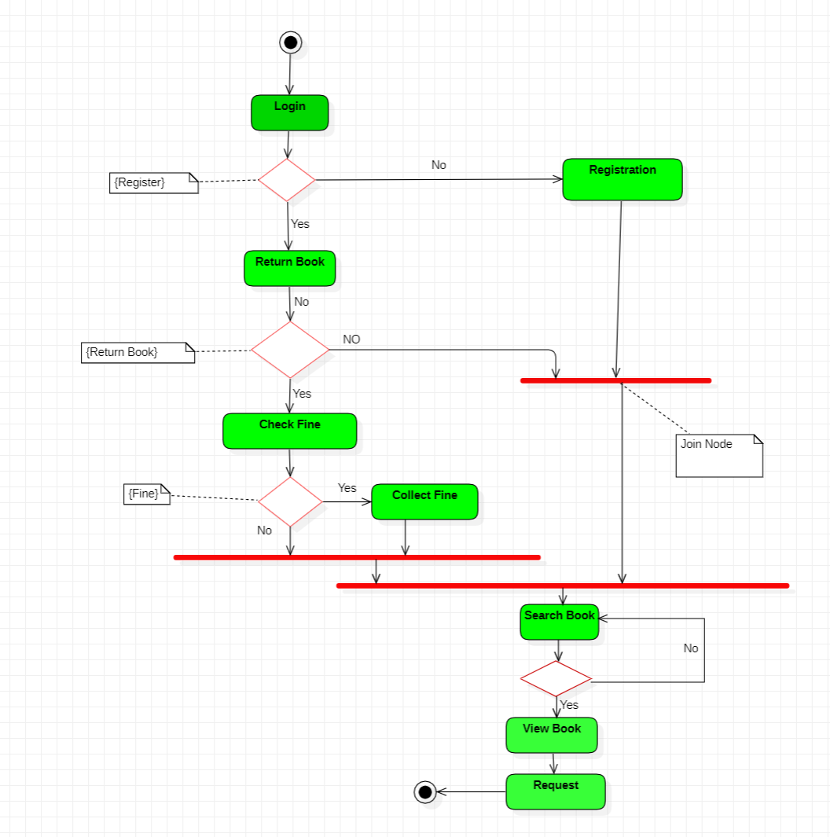
Example

Slide 10
Exercise
Online Shopping: Online customer can browse or search items, view specific item, add it to shopping cart, view and update shopping cart, checkout. User can view shopping cart at any time. Checkout is assumed to include user registration and login.
This example does not use partitions, most of the actions are assumed to be fulfilled by online customer.

Slide 11
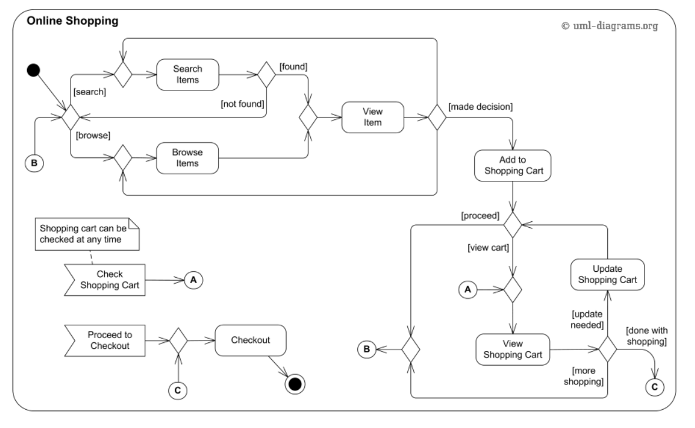

Slide 12
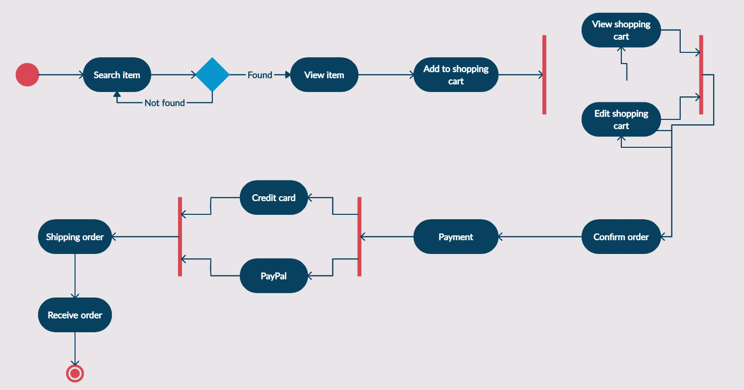
Online shopping

Slide 13
Lecture Assignment (ATM SYSTEM for ABC BANK)
Design activity diagram for the ABC BANK system…

Slide 14
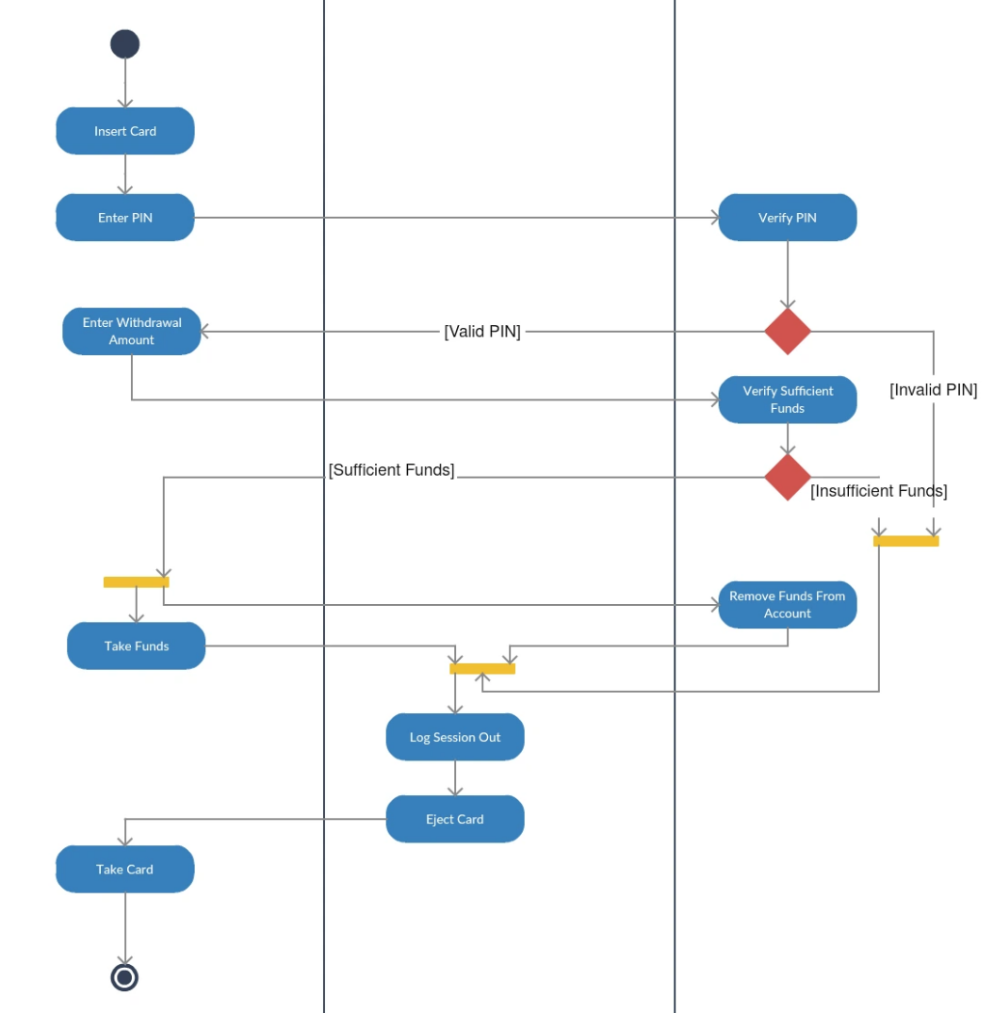
https://creately.com/guides/activity-diagram-tutorial/

